Slide 1
Generative models II Generative adversarial networks
Nikita Kazeev

Slide 2
Where can I use it?
Lots and lots of image manipulation fun
Lots and lots of text manipulation fun
Some (High-Energy) Physics, very preliminary:
Jets images
Simulations of calorimeters and RICH
Cosmological maps

Slide 3
Problem: comparing images
For naive pixel wise metric “cat on the left” is closer to “dog on the left” than to “cat on the right”
We may want to avoid that effect
Can we obtain image representation that is less sensitive to small shifts?

Slide 4
Ideas?
Do we have a representation that focuses on “semantics”?

Slide 5
Sketch: using pre-trained classifiers
Generator
Seed &
parameters
Classifier
(pretrained)
$$L=\left\|f\left(img\right)−f\left(Gen\left(seed\right)\right)\right\|$$
Real
image
Classifier
(pretrained)
MSE

Slide 6
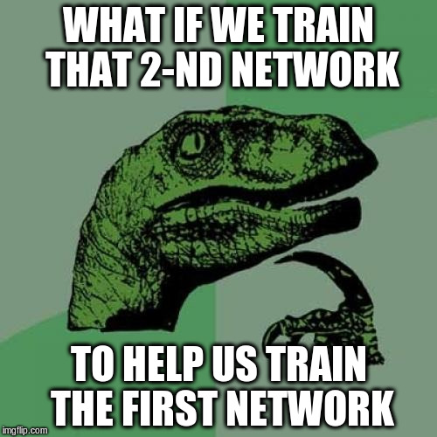

Slide 7

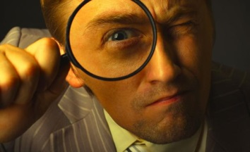
Generative Adversarial Networks
Generator
Discriminator
Content
Feedback
Generate image
(should be plausible)
Tell if image is plausible
(image) → P(fake)

Slide 8
Generative Adversarial Networks
Generator
Discriminator
Noise
/params
z
NN
Fake
Image
Image
(fake/real)
x
Other NN
P(real|image)

Slide 9
Training a GAN: Algorithm
for k in 1...K
sample a batch of noise z and images x
train step for discriminator
sample a batch of noise z and images x
train step for generator

Slide 10
Conditional Adversarial Networks
Image
Context
y
Fake
Image
Generator(z,y)
Noize
z
Context
y
Discriminator(x)
P(real|image,y)
Image
(fake/real)
x

Slide 11
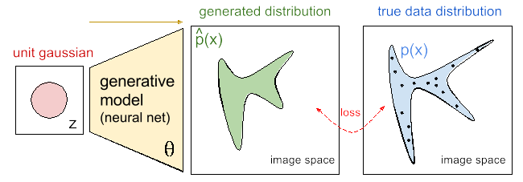
Do we really learn a distribution?
Image: https://blog.openai.com/generative-models/

Slide 12
How does one measure
the distance between
two distributions?

Slide 13
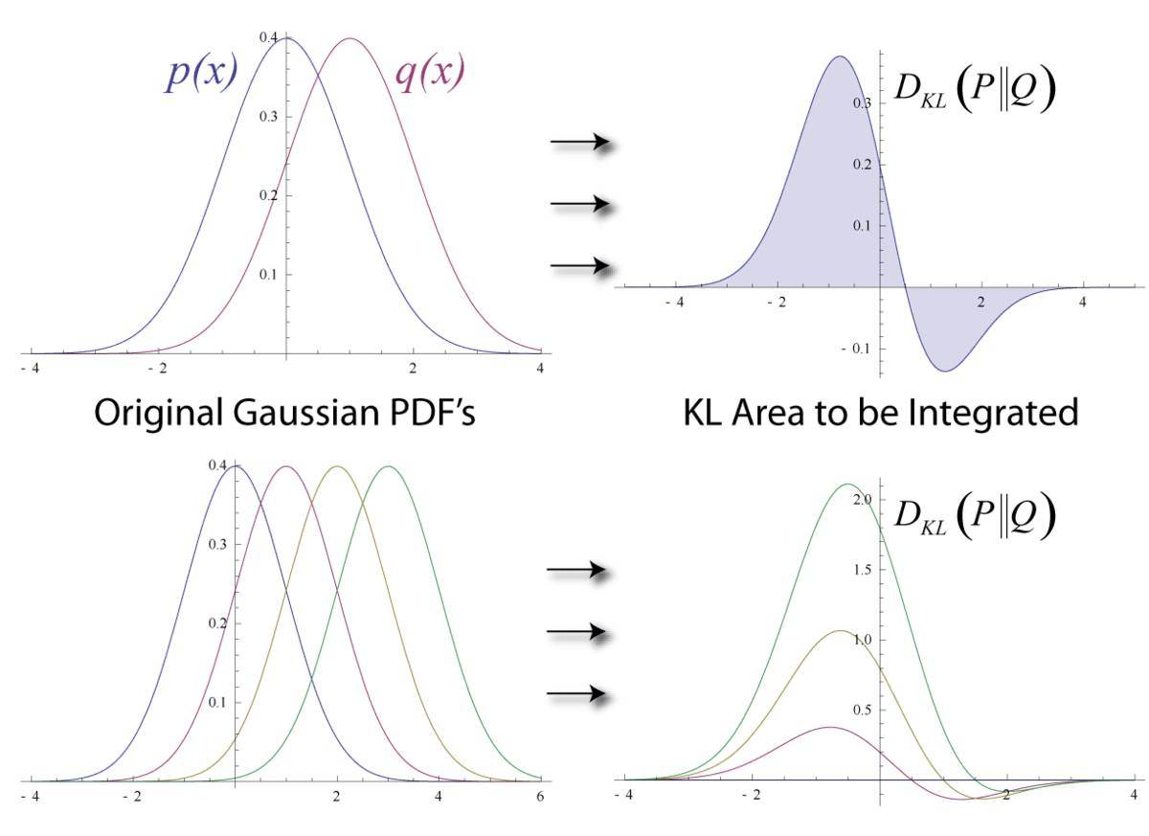
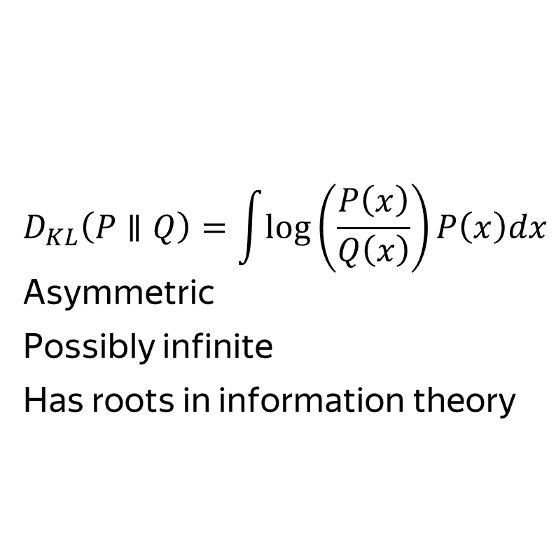
Kullback–Leibler divergence
$$D_{KL}\left(P∥Q\right)=\int{log}\left(\frac{P\left(x\right)}{Q\left(x\right)}\right)P\left(x\right)dx$$
Asymmetric
Possibly infinite
Has roots in information theory
Image: Wikipedia
Notes:
Kullback–Leibler divergence can be interpreted as the expected extra message-length per datum that must be communicated if a code that is optimal for a given (wrong) distribution Q is used, compared to using a code based on the true distribution P.

Slide 14
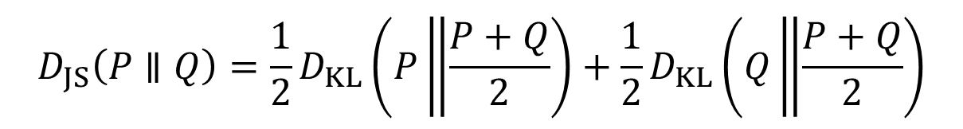
Jensen-Shannon (JS) divergence
$$D_{JS}\left(P∥Q\right)=\frac{1}{2}D_{KL}\left(P\left\|\frac{P+Q}{2}\right.\right)+\frac{1}{2}D_{KL}\left(Q\left\|\frac{P+Q}{2}\right.\right)$$
Historically was the first used in GANs (if you hear just “GAN”, it’s likely optimizing JS)
In theory, it’s proven that a GAN converges. In practice however...
Some believe that one reason behind GANs’ success is switching the loss from KL (usually used in maximum-likelihood approach) to JS

Slide 15
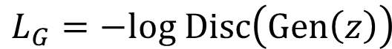
Jensen-Shannon aka “ordinary” GAN
Generator
Discriminator
$$L_{G}=−log Disc\left(Gen\left(z\right)\right)$$
Noise
/params
z
NN
Fake
Image
$$L_{D}=−log\left[1−Disc\left(Gen\left(z\right)\right)\right]−log Disc\left(x\right)$$
Image
(fake/real)
x
Other NN
P(real|image)

Slide 16
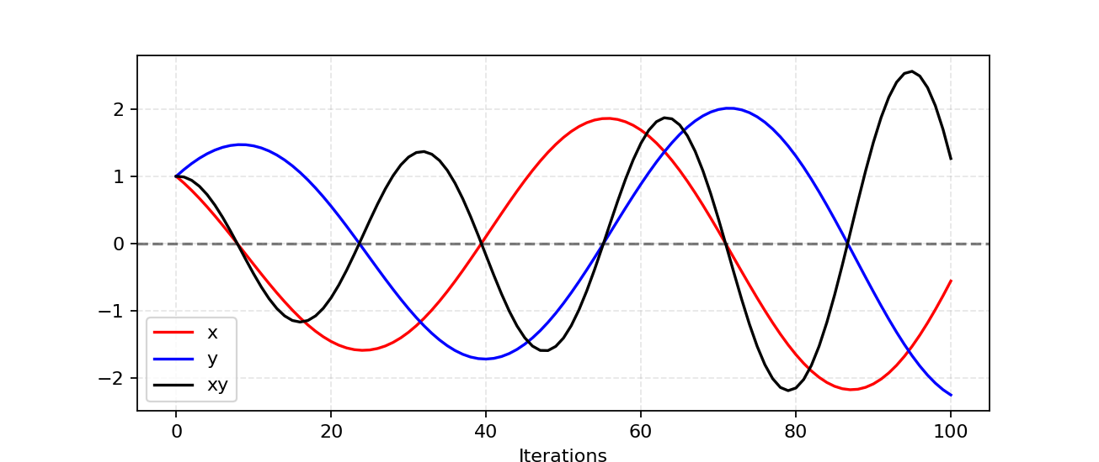
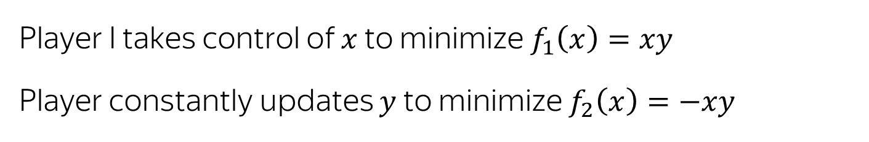
Problem #1: Hard to achieve Nash equilibrium
Player I takes control of $x$ to minimize$f_{1}\left(x\right)=xy$
Player constantly updates $y$ to minimize $f_{2}\left(x\right)=−xy$
https://lilianweng.github.io/lil-log/2017/08/20/from-GAN-to-WGAN.html

Slide 17
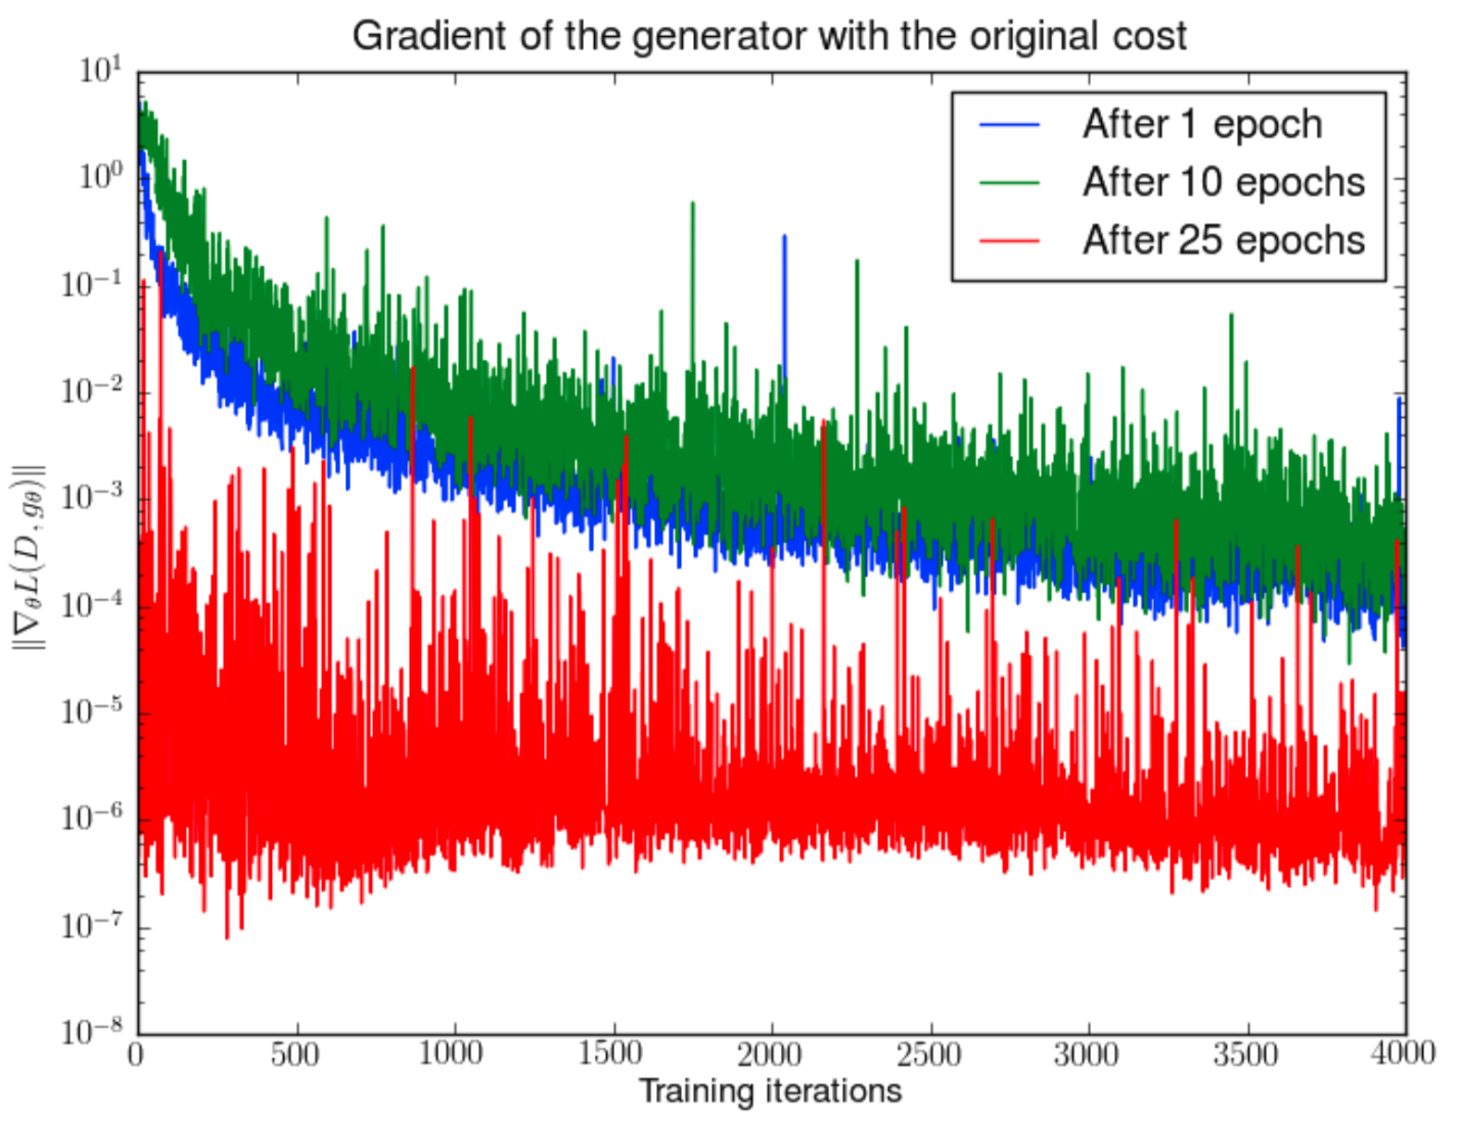
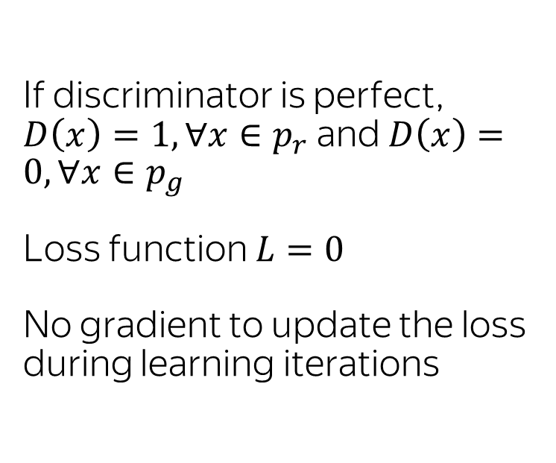
Problem #2: Vanishing gradient
If discriminator is perfect, $D\left(x\right)=1, ∀x∈p_{r}$ and $D\left(x\right)=0, ∀x∈p_{g}$
Loss function $L=0$
No gradient to update the loss during learning iterations
https://arxiv.org/pdf/1701.04862.pdf

Slide 18
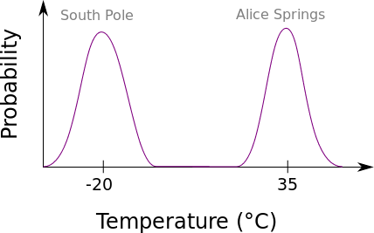
Problem #3: Mode collapse
Generator can converge to cover just a part of the phase space
http://aiden.nibali.org/blog/2017-01-18-mode-collapse-gans/

Slide 19
Problem #4 No convergence metric
Theoretically, there is a Nash equilibrium
In practice it is usually not achieved
Hard to devise a stopping criteria

Slide 20
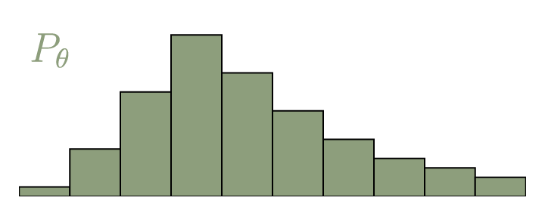
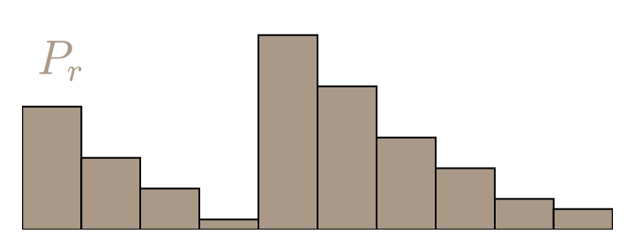
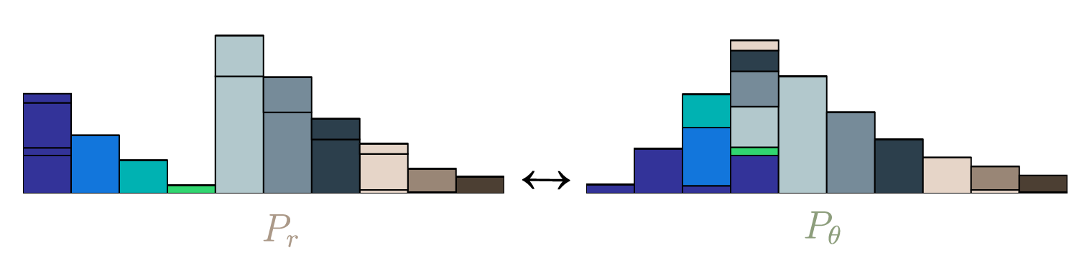
Wasserstein distance aka Earth Mover’s distance aka EMD
https://vincentherrmann.github.io/blog/wasserstein/

Slide 21
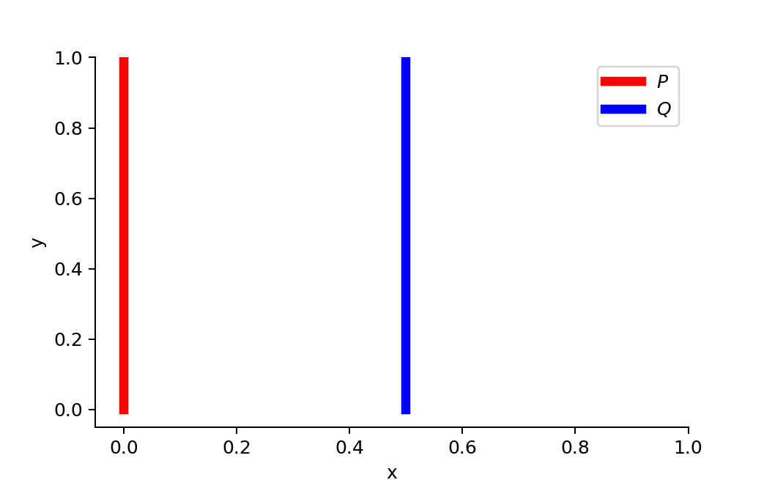
Why Wasserstein is better than JS or KL divergence? #1
Smooth measure, even for disjoint distributions
JS is constant with no gradient
KL would have given us infinity

Slide 22
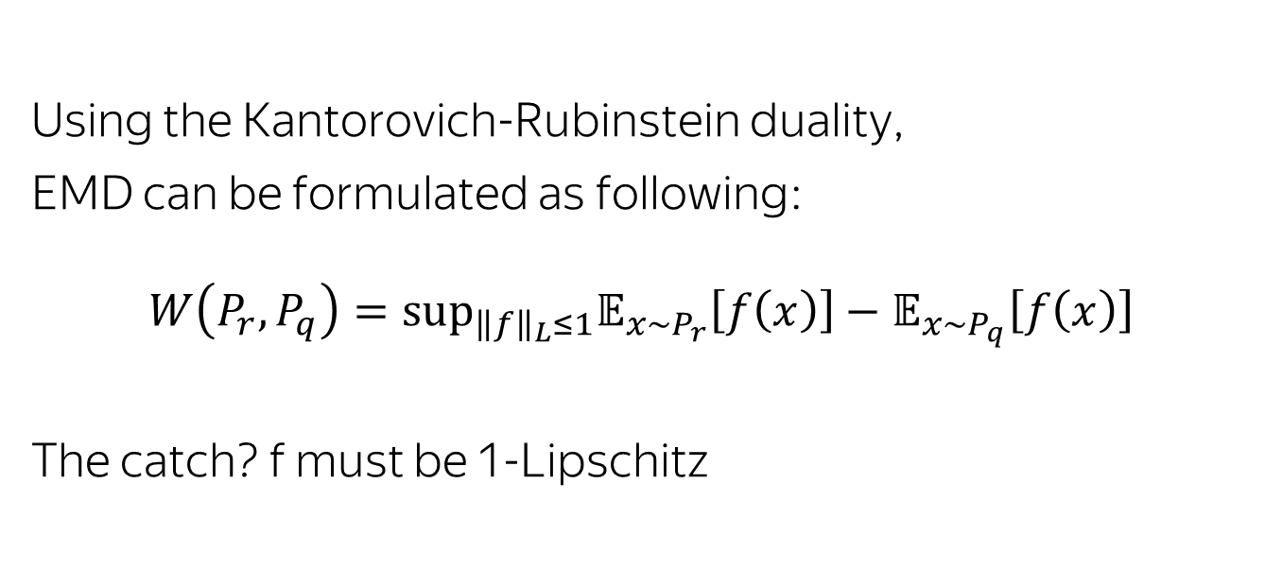
WGAN formulation
Using the Kantorovich-Rubinstein duality,
EMD can be formulated as following:
$$W\left(P_{r},P_{q}\right)={\text{sup}}_{{\left\|f\right\|}_{L}≤1}𝔼_{x∼P_{r}}\left[f\left(x\right)\right]−𝔼_{x∼P_{q}}\left[f\left(x\right)\right]$$
The catch? f must be 1-Lipschitz

Slide 23
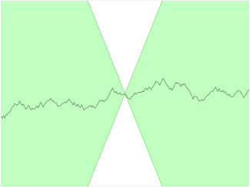
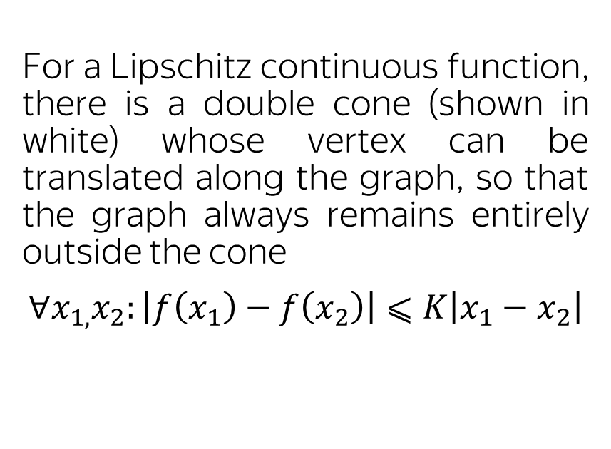
K-Lipschitz functions
For a Lipschitz continuous function, there is a double cone (shown in white) whose vertex can be translated along the graph, so that the graph always remains entirely outside the cone
$$∀x_{1,}x_{2}:\left|f\left(x_{1}\right)−f\left(x_{2}\right)\right|⩽K\left|x_{1}−x_{2}\right|$$
Wikipedia

Slide 24
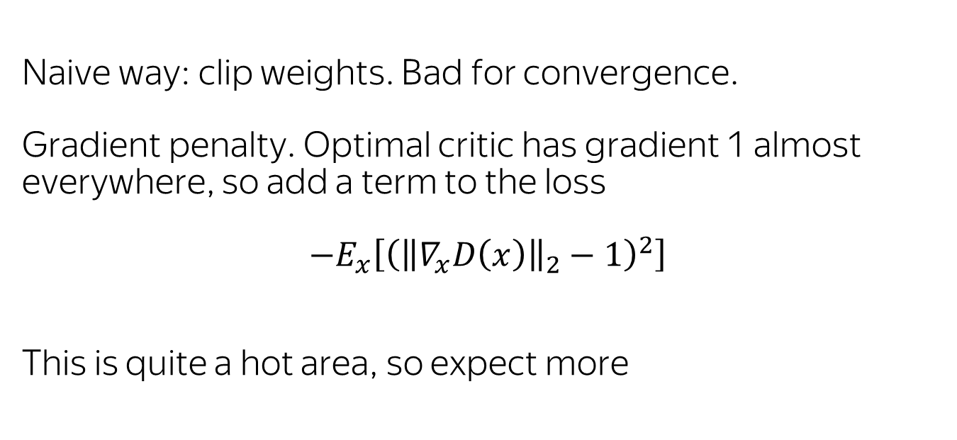
Lipschitz continuity and NN
Naive way: clip weights. Bad for convergence.
Gradient penalty. Optimal critic has gradient 1 almost everywhere, so add a term to the loss
$−E_{x}\left[{\left({\left\|∇_{x}D\left(x\right)\right\|}_{2}−1\right)}^{2}\right]$
This is quite a hot area, so expect more

Slide 25
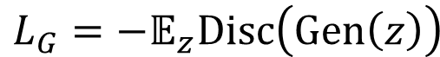
WGAN-GP
Generator
$$L_{G}=−𝔼_{z}Disc\left(Gen\left(z\right)\right)$$
Noise
/params
z
NN
Fake
Image
Discr.
$$L_{D}=𝔼_{Z}Disc\left(Gen\left(z\right)\right)−𝔼_{X}Disc\left(x\right)−λ𝔼_{x}\left[{\left({\left\|∇_{x}Disc\left(x\right)\right\|}_{2}−1\right)}^{2}\right]$$
Image
(fake/real)
x
Other NN
P(real|image)

Slide 26
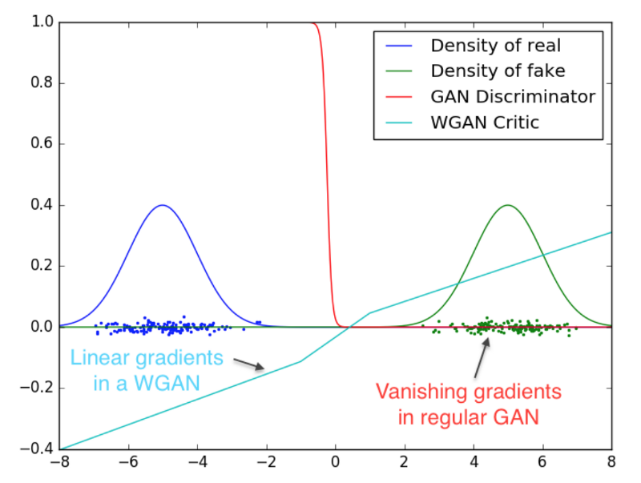
Why Wasserstein might be better than JS or KL divergence? #2
No vanishing gradients
https://arxiv.org/pdf/1701.07875.pdf

Slide 27
Practical way to enforce gradient penalty
Enforcing the unit gradient norm constraint everywhere is intractable
The authors propose choosing random points on lines connecting generated and real examples

Slide 28
Why Wasserstein might be better than JS or KL divergence? #3
WGAN critic can be trained until convergence
WGAN critic loss is a meaningful estimate of EMD between the real and generated data

Slide 29
However
WGAN:
Doesn’t go well batch norm
Has slower convergence
Doesn’t work with some (e. g.) ELU activations
Less papers exploring architectures and heuristics

Slide 30
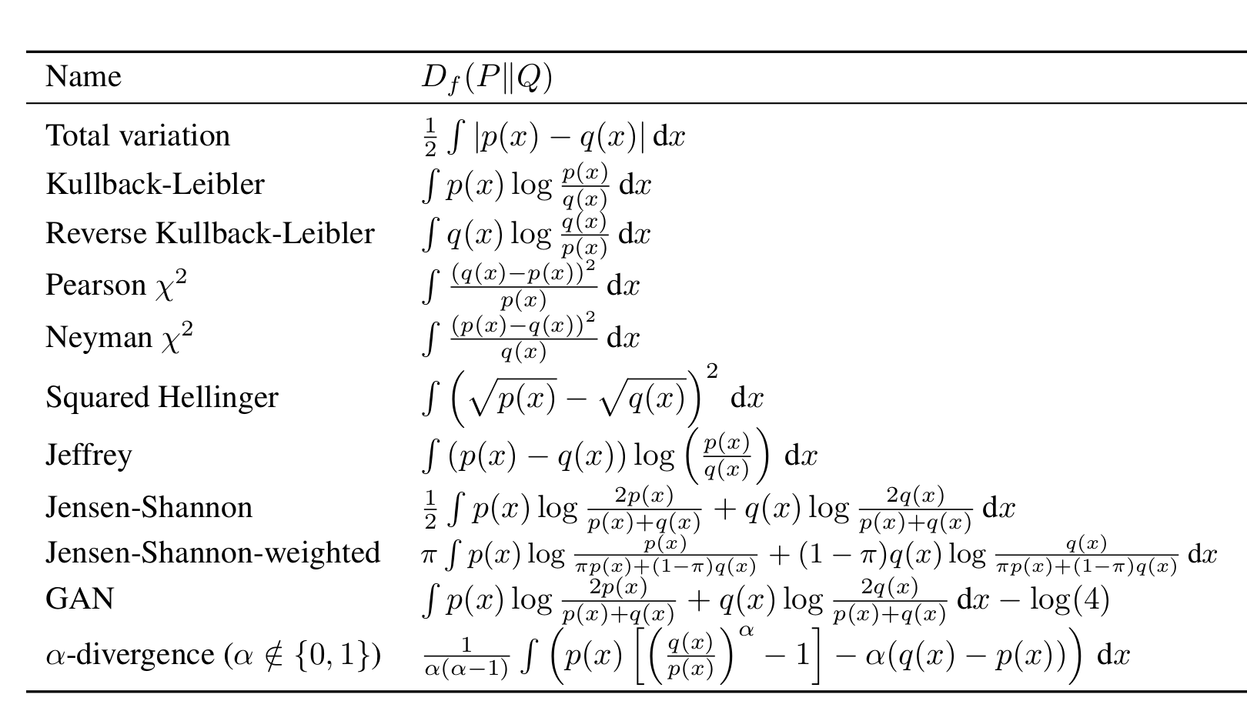
Note: there are other metrics
f-GAN: Training Generative Neural Samplers using Variational Divergence Minimization

Slide 31
Training a GAN
How many iterations of generator and discriminator training?
For JS usually around 1:1
For WGAN, the original paper used 5 discriminator per 1 generator – but you can make it as high as you want

Slide 32
Heuristics for Convolutional GANs (DCGAN)
Replace any pooling layers with strided convolutions (discriminator) and fractional-strided convolutions (generator)
Use batchnorm in both the generator and the discriminator
Remove fully connected hidden layers for deeper architectures
Use ReLU activation in generator for all layers except for the output, which uses Tanh
Use LeakyReLU activation in the discriminator for all layers
https://arxiv.org/abs/1511.06434

Slide 33
Intermission: Measuring datasets similarity

Slide 34
Measuring datasets similarity
Sometimes one just has several complex datasets and needs a to measure a meaningful distance between them
FastFoo generator vs. data
MC vs data

Slide 35
Measuring datasets similarity: classifier AUC
Pick your favorite classifier (NN, gradient boosting, whatever)
Use cross-validation to check whether it is able to distinguish the datasets
Pro: easy to understand AUC
Con: no real theoretical guarantees
Con: answer depends on the classifier

Slide 36
Measuring datasets similarity: EMD
Train a Wasserstein discriminator
Pro: EMD has a well defined meaning
Con: the number is not exactly EMD, there is uncertainty due to the optimization procedure and the way Lipschitz continuity is enforced

Slide 37
GANs @ HEP

Slide 38
Classic cWGAN for Cherenkov detector high-level observables
Generator
Discriminator
Track kinematics
Event occupancy proxies
Track DLLs
Generator
Fully-connected NN
concatenation
Noise
Track kinematics
Event occupancy proxies
Critic aka discriminator
Fully-connected NN
concatenation
Track DLLs
real/generated
https://rich2018.org/indico/event/1/contributions/89/

Slide 39
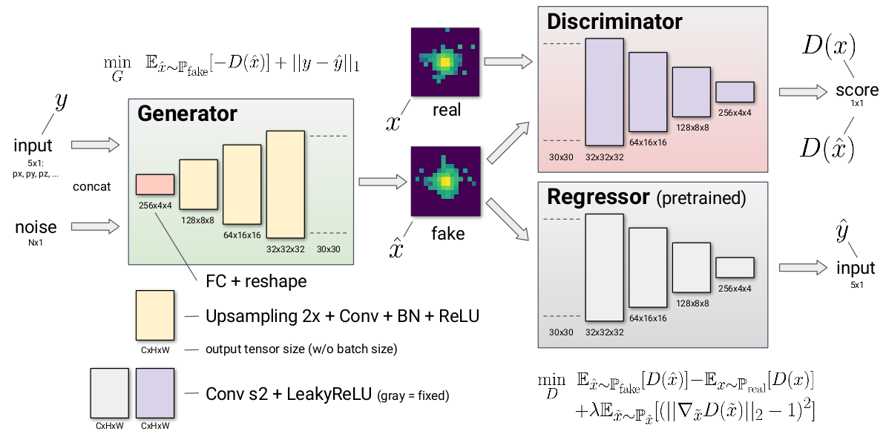
Calorimeter response generation
https://indico.cern.ch/event/587955/contributions/2937612/attachments/1680985/2704964/chep-fast-sim_last3.pdf

Slide 40
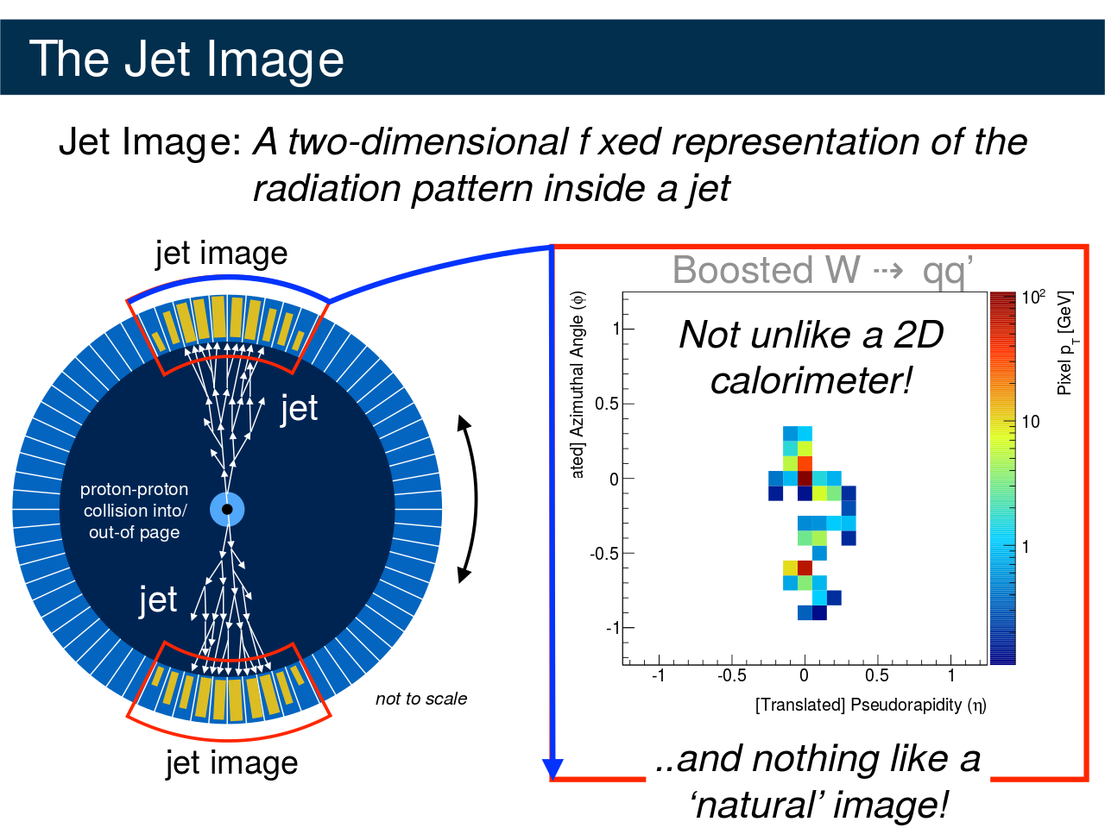
axiv, arxiv

Slide 41
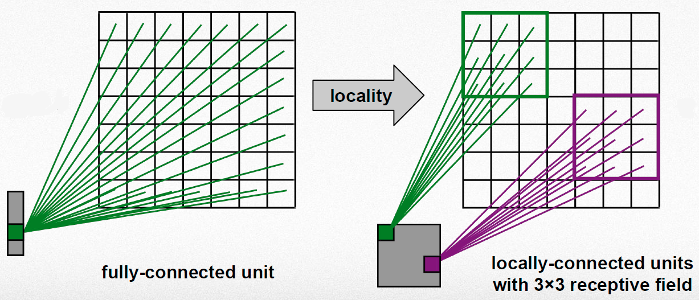
Recap: Locally Connected Layer

Slide 42
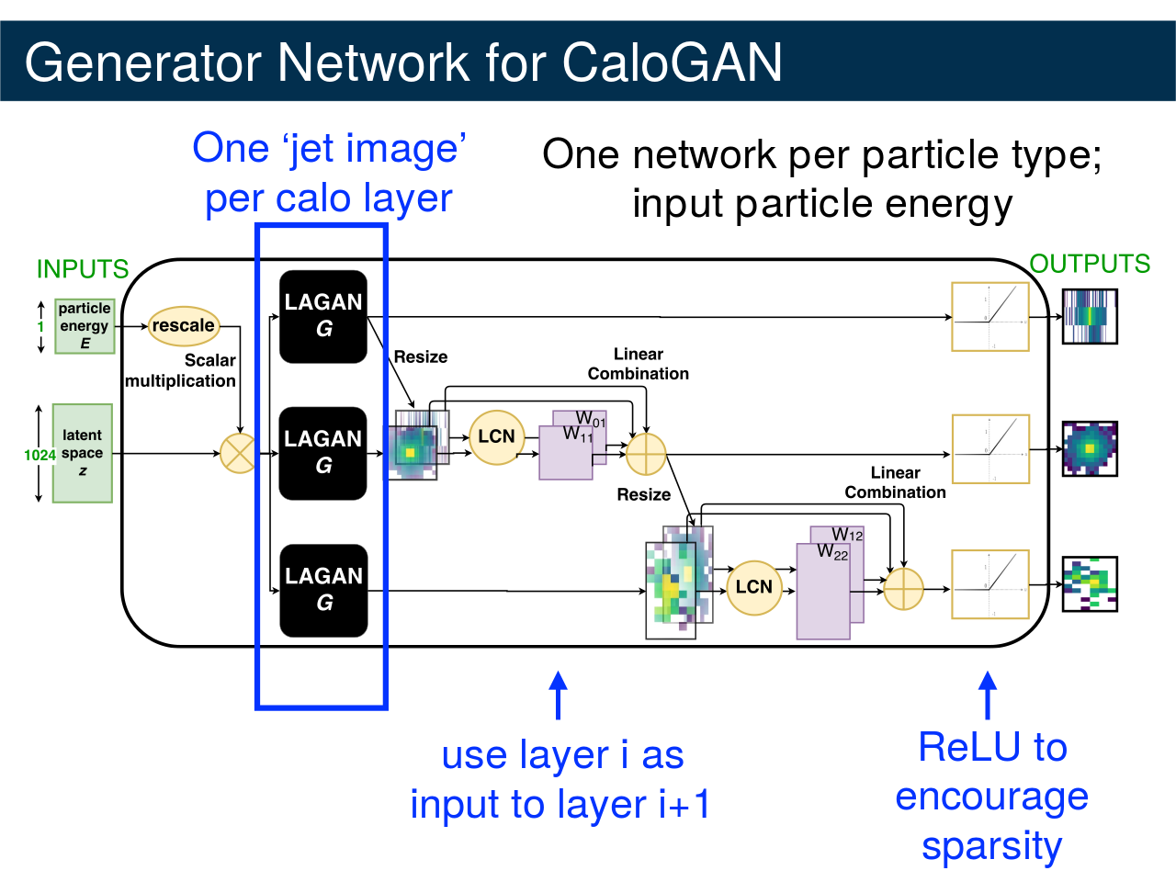

Slide 43
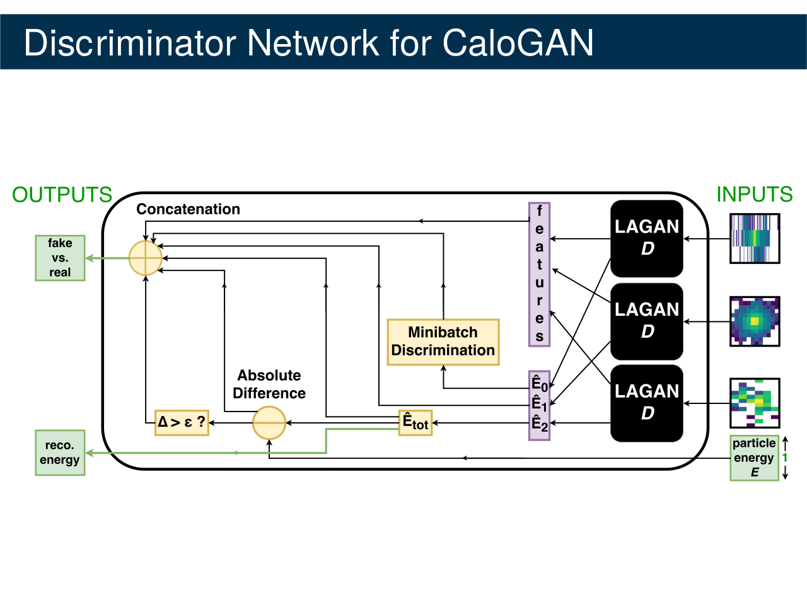

Slide 44
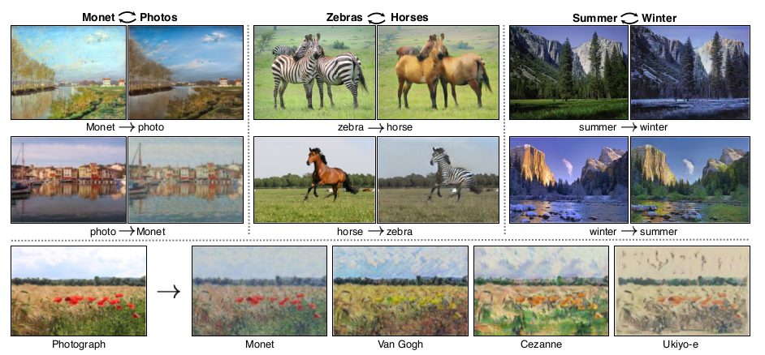
Cycle GAN for unpaired images
https://arxiv.org/abs/1703.10593

Slide 45
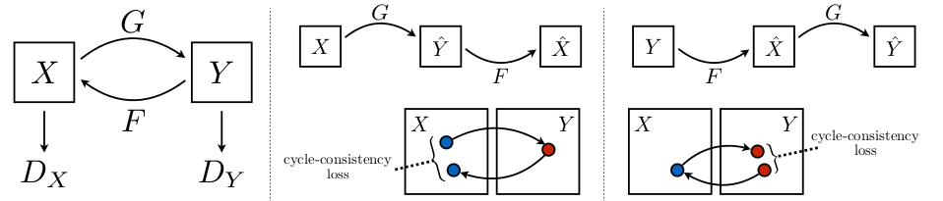
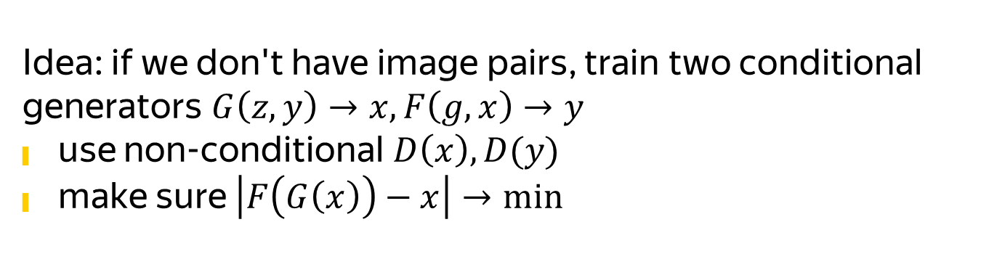
Cycle GAN for unpaired images
Idea: if we don't have image pairs, train two conditional generators $G\left(z,y\right)→x, F\left(g,x\right)→y$
use non-conditional $D\left(x\right), D(y)$
make sure $\left|F\left(G\left(x\right)\right)−x\right|→min$

Slide 46
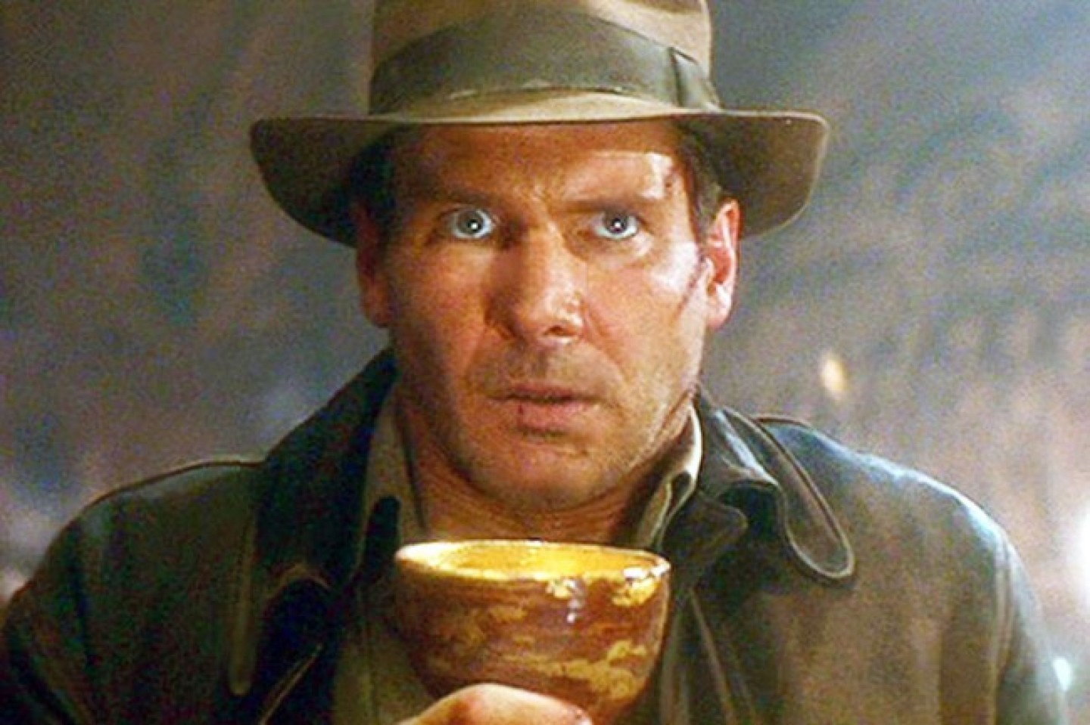
Data ↔ MC ?
Image: Indiana Jones and the Last Crusade

Slide 47
PartyGAN or Maxim’s quest for the Holy Grail

Slide 48
Feel free to drop a line
Nikita Kazeev
HSE, Rome Sapienza, YSDA, trace amounts of Yandex proper
kazeevn@yandex-team.ru
telegram.me/kazeevn

Slide 49
Bonus

Slide 50
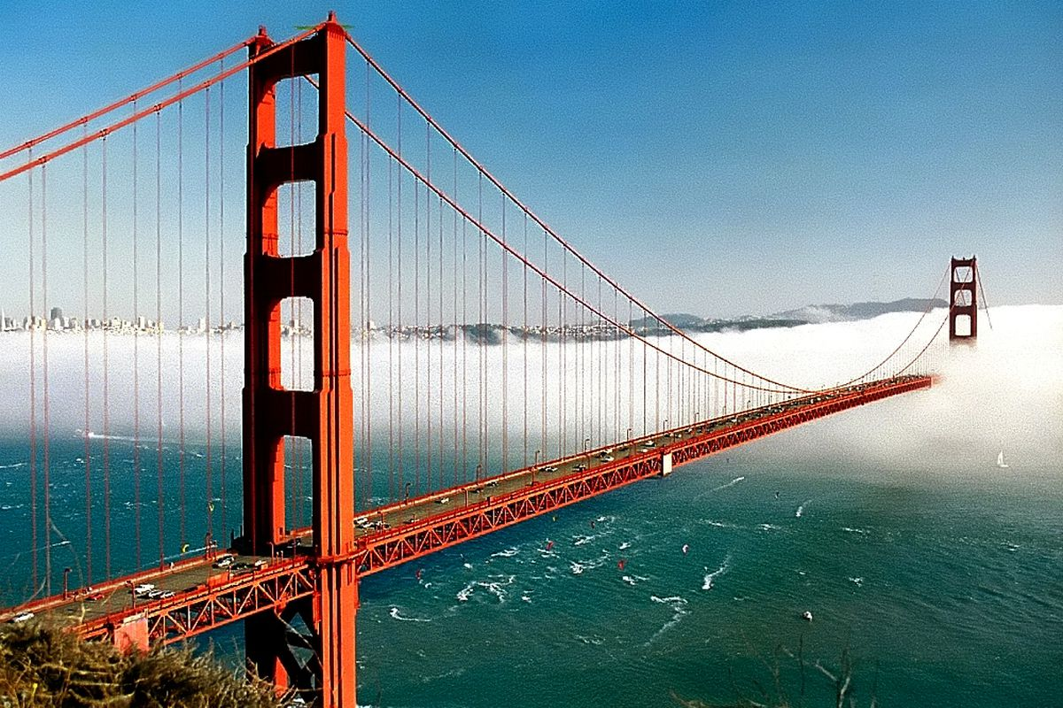
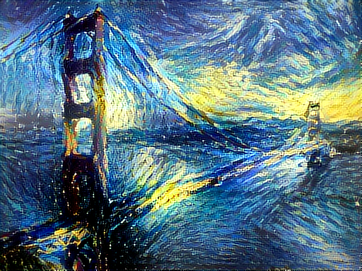
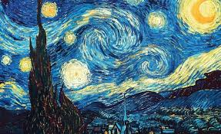
Art style transfer
+
=

Slide 51
Art style transfer
Ideas?

Slide 52
Art style transfer
Formulate and optimize texture loss
$$L=\left\|Texture\left(x_{ref}\right)−Texture\left(x_{cand}\right)\right\|+\left\|Content\left(x_{orig}\right)−Content\left(x_{cand}\right)\right\|$$
Reference
image
VGG16
(pretrained)
First K layers
Compute
Gram matrix
Texture
features
Original
image
VGG16
(pretrained)
Almost full
Content
features

